Slide 1
Big Data Analytics Project
Abhishek
Phase 2
11/17/20

Slide 2

Team Yellow
Abhishek
Alekhya Sangem
Vatsal Shah
Abhishek Shenoy
Akshay Shirsat
Bikram Singh
Meng Sui

Slide 3
Data Preparation
Abhishek

Slide 4
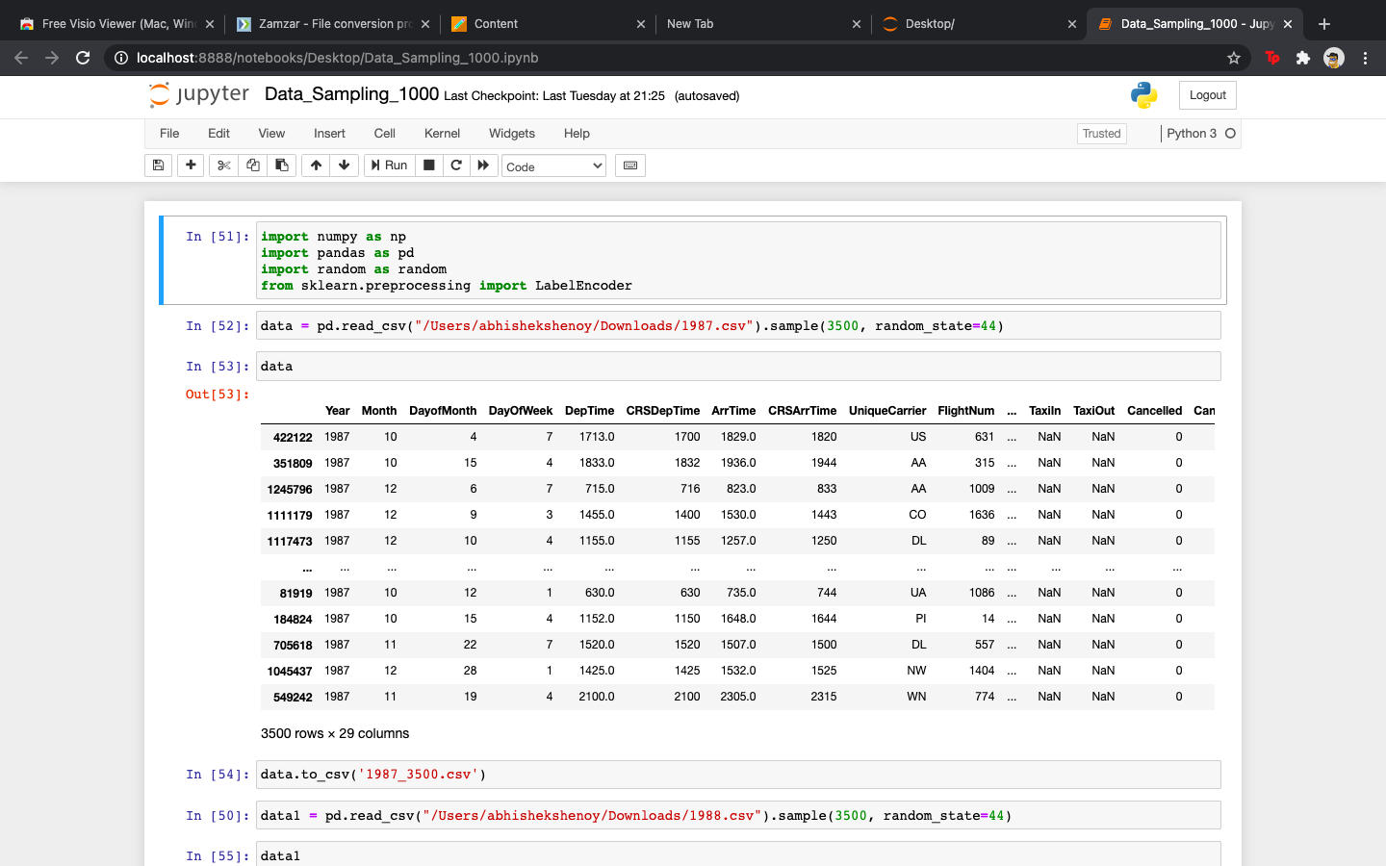
Abhishek
Sample of 3500 records
The following code on python helped us achieve random 3500 records on all the years we selected
1987,1988,1989,1990,1991, and 2001.

Slide 5
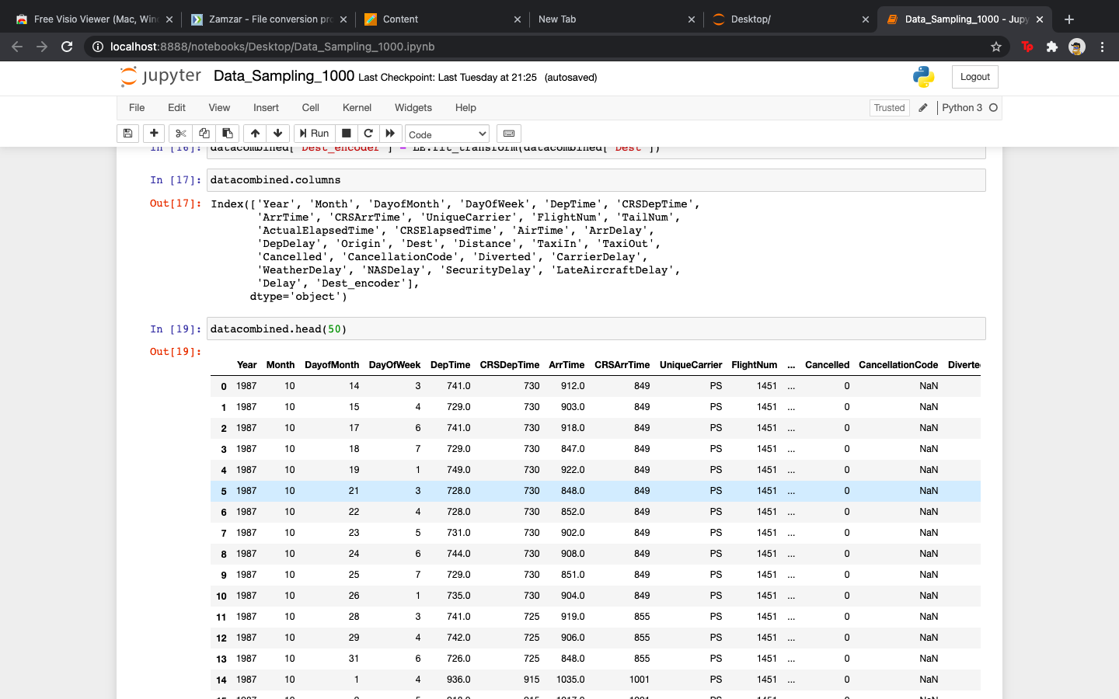
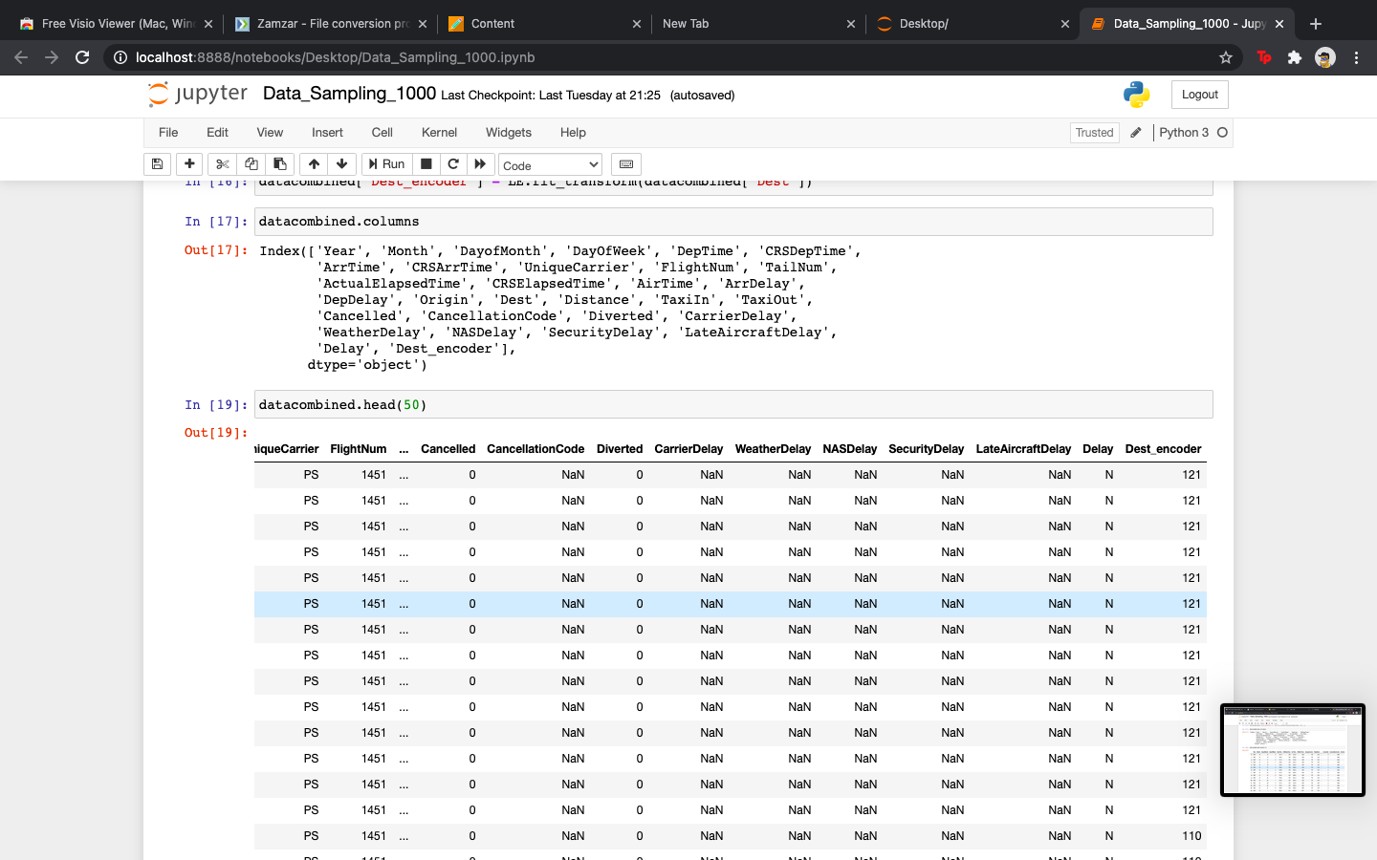
Merged File of All Years
Abhishek
Merging all the years column & creating a Combined file of all years with 21000 records.

Slide 6
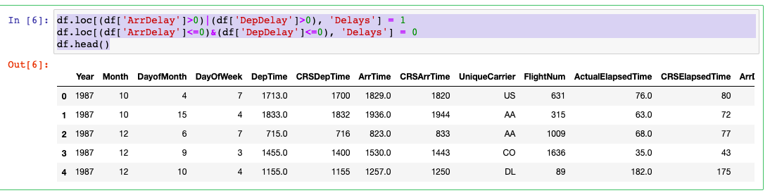
Creating a New Column 'Delays'
Vatsal
Using the above code on python we managed to create a delay column with ‘Y’ & ‘N’ for machine learning model.

Slide 7
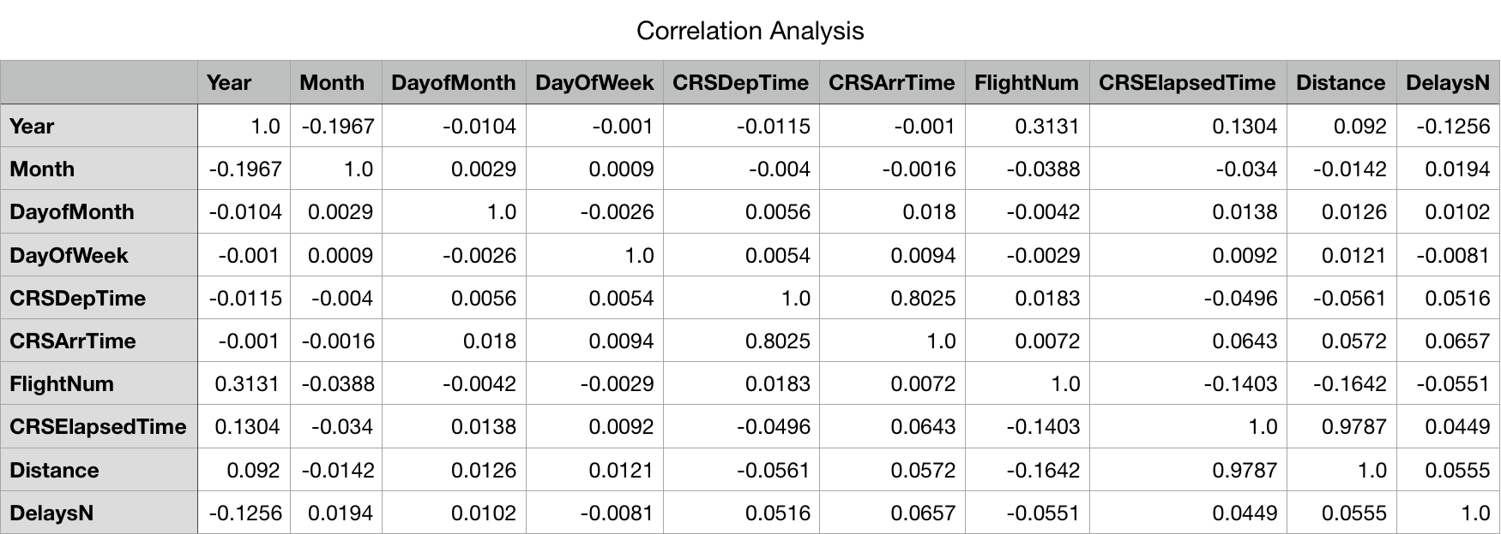
Correlation Analysis Table
Akshay

Slide 8
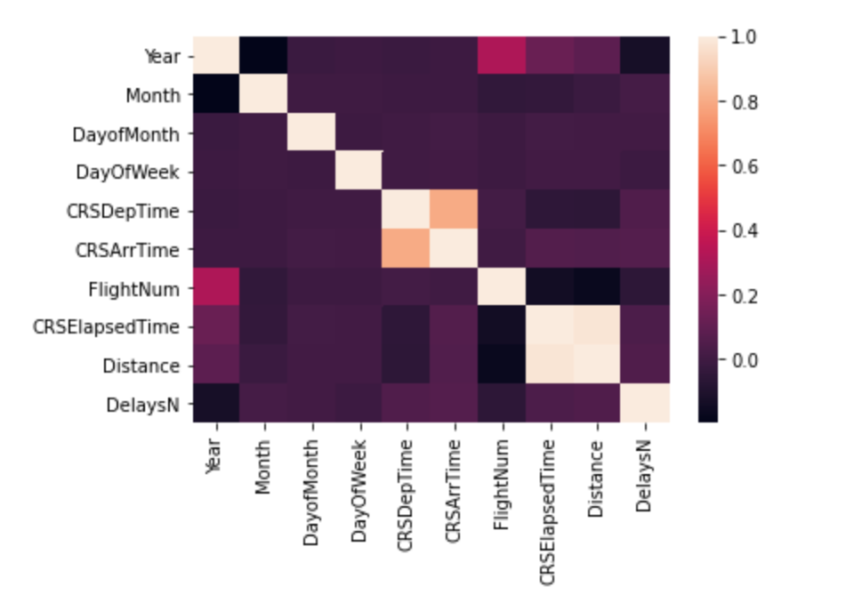
Heat Map for Correlation Analysis
Akshay
We can observe from the heat map that ArrTime and DepTime have the highest correlation coefficient.
ArrTime Delay and DepTime delay are related to each other

Slide 9
Checking Accuracy of Model
Akshay
While checking the accuracy of model with initial 6000 records as proposed, the accuracy of the model was only 70 % on all major supervised machine learning models.
This issue was further discussed with the business partner(professor) & we were asked to increase the sample records on each years to check if this help us increase the accuracy.
We further used 3500 random records from each year & combined the file to get a total records of 21000.

Slide 10
Data Visualization
Bikram

Slide 11
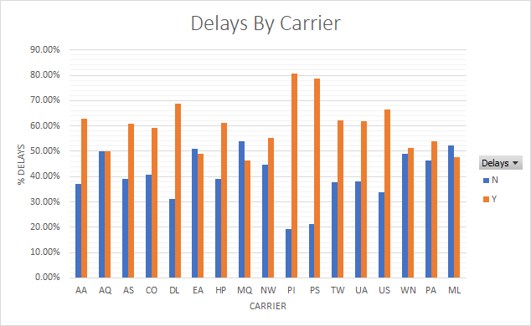
21000 Records Data
Bikram

Slide 12
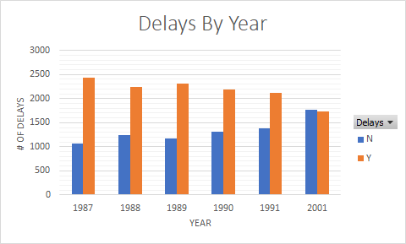
21000 Records Data
Bikram

Slide 13
Choosing an Algorithm
Meng

Slide 14
Decision Tree Logistic Regression Support Vector Machine (SVM) Naïve Bayes K-Nearest Neighbors(KNN) Random Forest
Meng

Slide 15
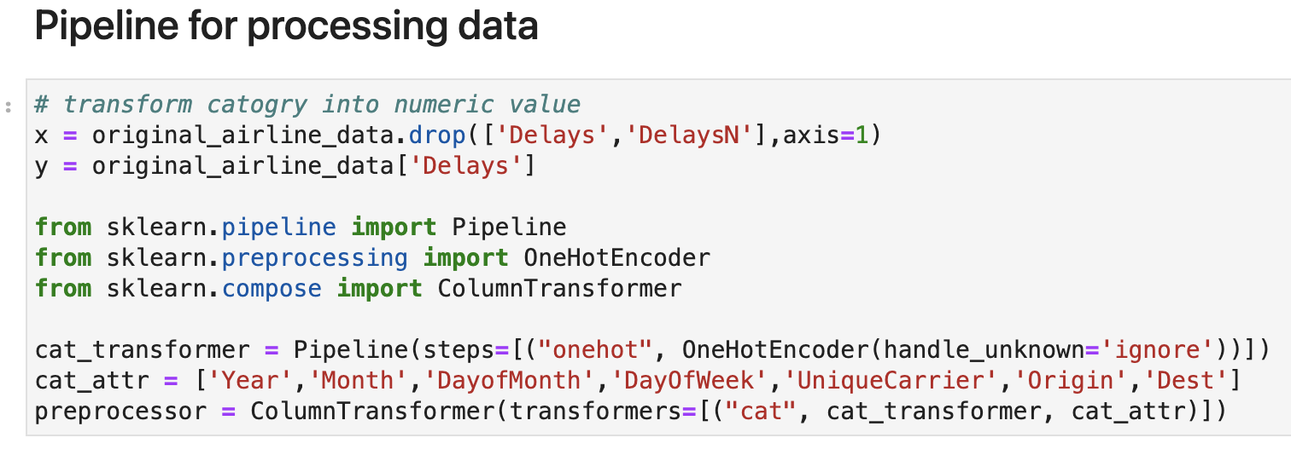
Data Transformation
Meng

Slide 16
OneHotEncode Transform
Meng
UniqueCarrier |  | UniqueCarrier_UA | UniqueCarrier_AA | UniqueCarrier_MQ | UniqueCarrier_OO | … | UniqueCarrier_CO
UA |  | 1 | 0 | 0 | 0 | … | 0
AA |  | 0 | 1 | 0 | 0 | … | 0
MQ |  | 0 | 0 | 1 | 0 | … | 0
OO |  | 0 | 0 | 0 | 1 | … | 0
UA |  | 1 | 0 | 0 | 0 | … | 0
AA |  | 0 | 1 | 0 | 0 | … | 0
OO |  | 0 | 0 | 0 | 1
… |  | … | … | … | … | … | …
CO |  | 0 | 0 | 0 | 0 | … | 1

Slide 17
Compare LabelEncode to OneHotEncode
Meng
UniqueCarrier | LabelEncode | UniqueCarrier | OneHotEncode | UniqueCarrier_UA | UniqueCarrier_AA | UniqueCarrier_MQ | UniqueCarrier_OO | … | UniqueCarrier_CO
1 |  | UA |  | 1 | 0 | 0 | 0 | … | 0
2 |  | AA |  | 0 | 1 | 0 | 0 | … | 0
3 |  | MQ |  | 0 | 0 | 1 | 0 | … | 0
4 |  | OO |  | 0 | 0 | 0 | 1 | … | 0
1 |  | UA |  | 1 | 0 | 0 | 0 | … | 0
2 |  | AA |  | 0 | 1 | 0 | 0 | … | 0
4 |  | OO |  | 0 | 0 | 0 | 1
... |  | … |  | … | … | … | … | … | …
100 |  | CO |  | 0 | 0 | 0 | 0 | … | 1

Slide 18
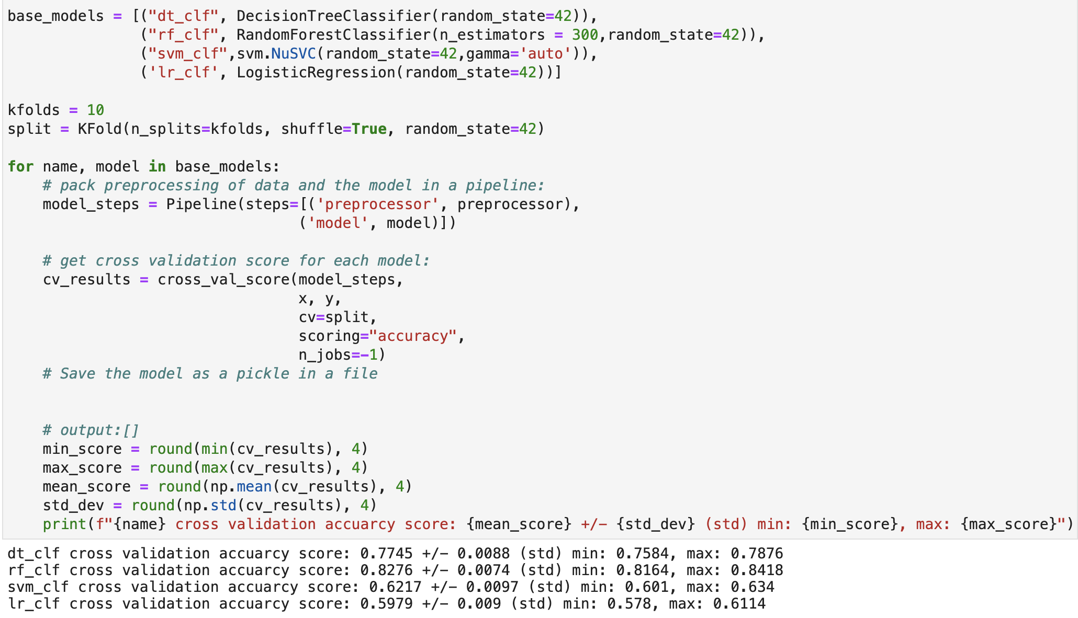
Algorithms Comparison
Meng
Loop
Pipeline to combine data transform and training steps
10 Folded cross validation
Output cross validation results for each model
Random Forest has the highest accuracy

Slide 19
Prediction
Alekhya

Slide 20
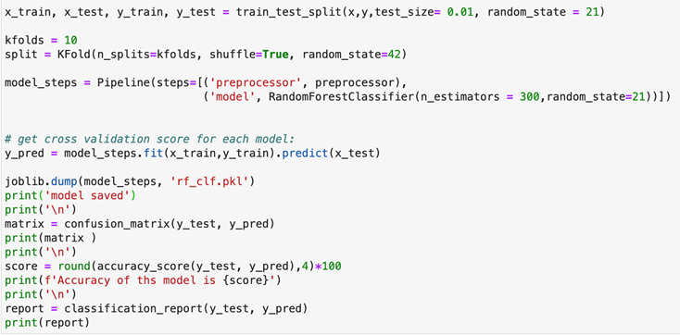
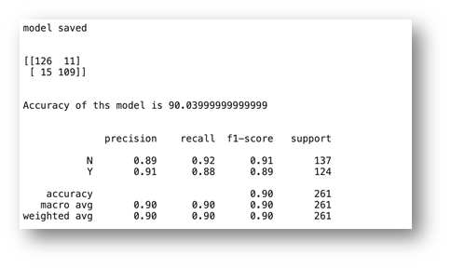
Model Report - Random Forest
Alekhya

Slide 21
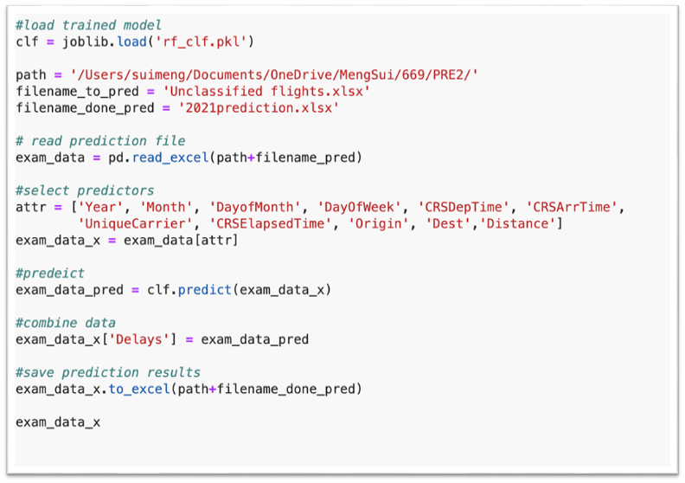
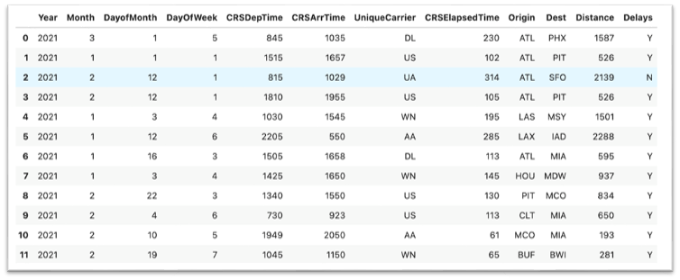
Prediction - Random Forest
Alekhya

Slide 22
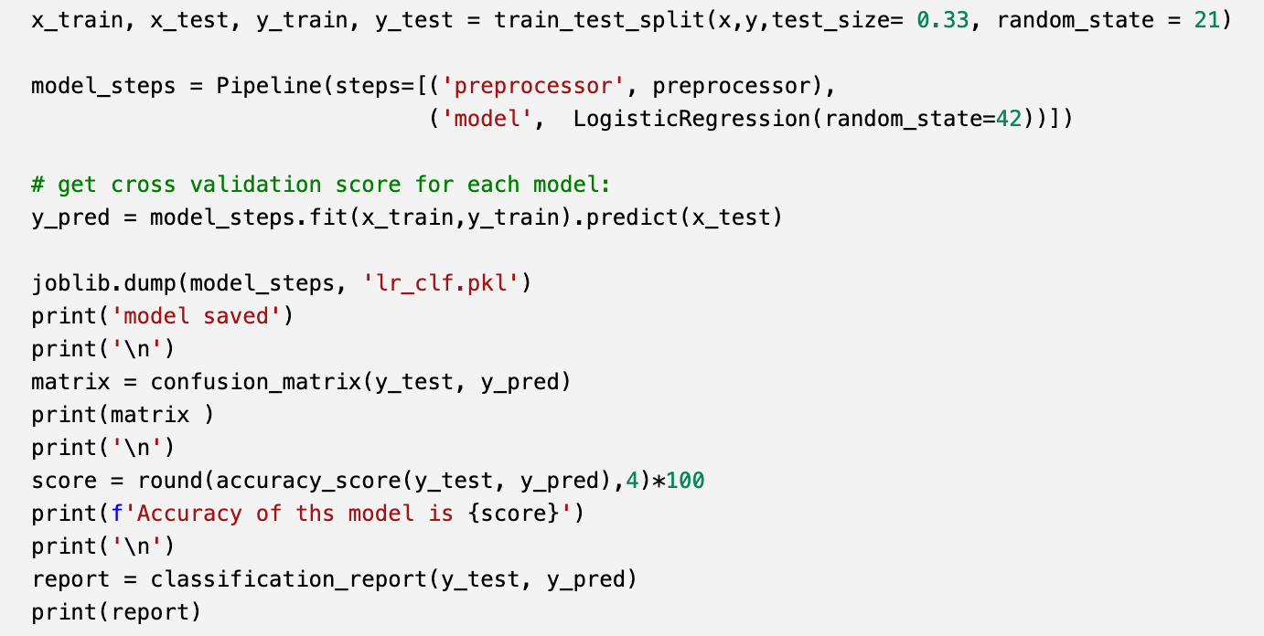
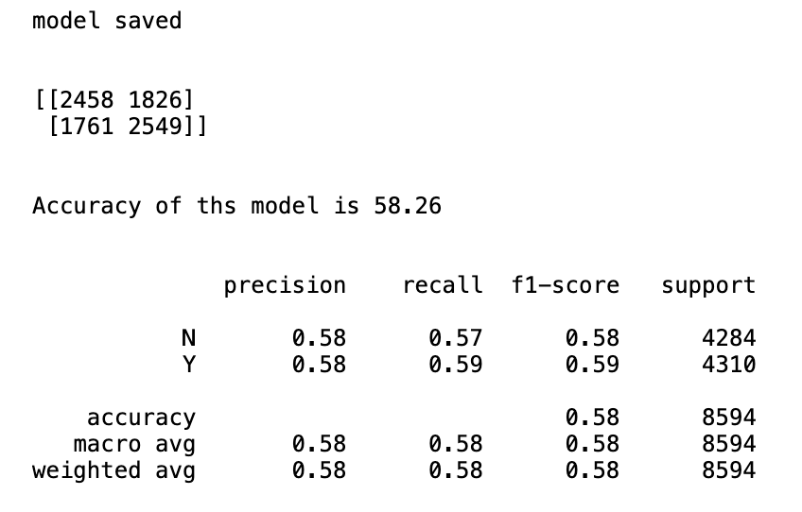
Model Report – Logistic Regression
Alekhya

Slide 23
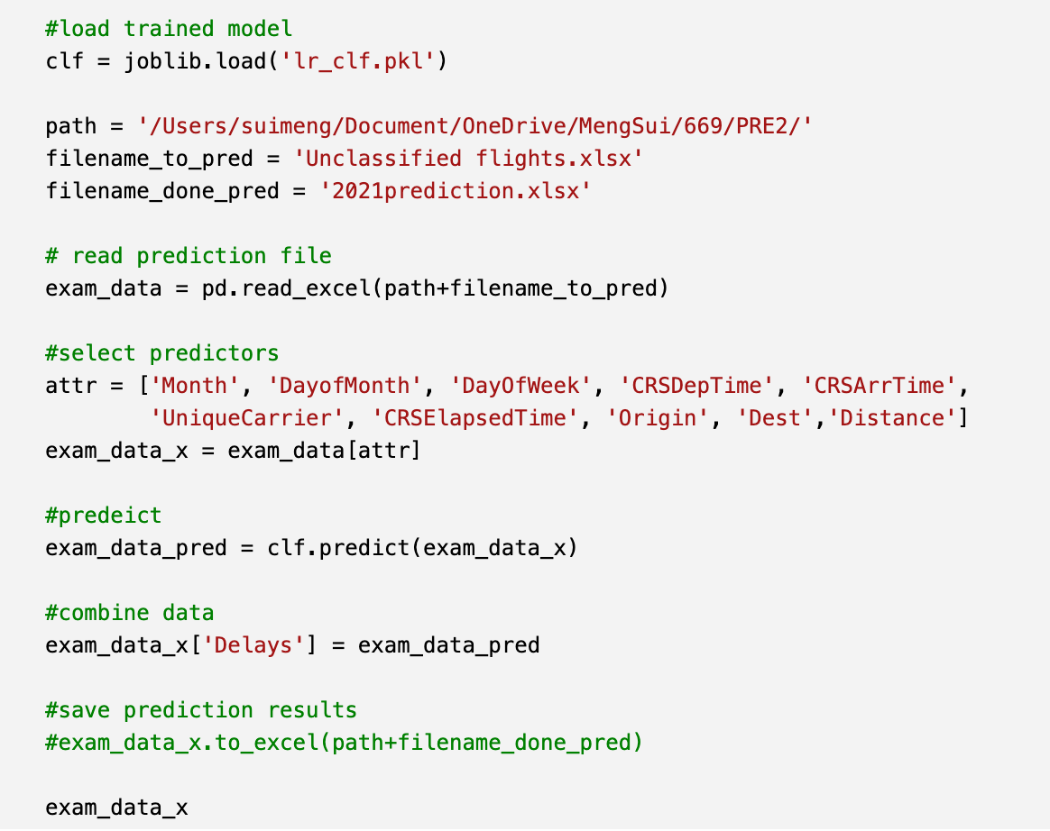
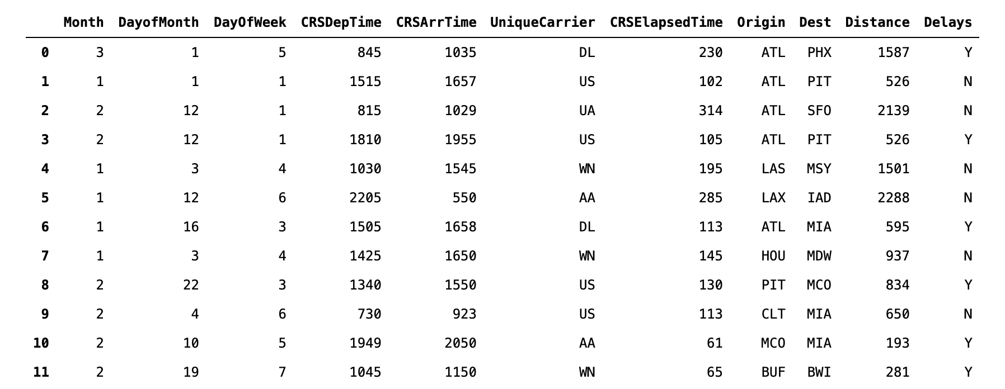
Prediction– Logistic Regression
Alekhya

Slide 24
Summary
Bikram
Accuracy of predictive models in Python & RapidMiner remained stuck at 64% at first
We ran several models in RapidMiner but were unable to successfully increase our accuracy
We were able to overcome this problem in Python by increasing our sample size and changing our encoding method
Upon the suggestion of the business partner (professor), we increased our sample size to 21000
We also dropped all but the 'Month,' 'DayofMonth,' 'CRSDepTime,' 'CRSArrTime,' 'UniqueCarrier,' 'FlightNumber,' 'CRSElapsedTime,' 'Origin,' 'Dest,' and 'Distance' columns
We also changed the categorical encoder from LabelEncodeTransform to OneHotEncode
After taking all these measures, we achieved the desired minimum accuracy of 90 %
Out of the various models we tested, the Random Forest model yielded the highest accuracy for our data set. But it only predicted 11 out of 12 ‘yes’ delays when we deployed it to predict new data. It is not the best model even if it has the highest accuracy.
Logistic regression turned out to be the best model in terms of predicting new data. It predicted 6 out of 12 as ’yes’ delays, which is the closest to the model's prediction threshold

Slide 25
Thank You!

